Slide 1



SYNTHETIC NATURAL GAS & HYDROGEN PRODUCTION TECHNOLOGIES LAB
Research Focus & Functions & Services
Prof. Dr. Ahmet Erhan Aksoylu
Dr. Burcu Selen Çaglayan

Slide 2



SNG & HydTec Lab, Science & Technology Building Block B, Kandilli Campus, Boğaziçi University, 34684, Kandilli, İstanbul, Turkey
SNG & HydTec Lab @ ChE, Department of Chemical Engineering, Square Building, North Campus, Boğaziçi University, 34342, Bebek, İstanbul, Turkey
http://snghydtec.boun.edu.tr
2

Slide 3
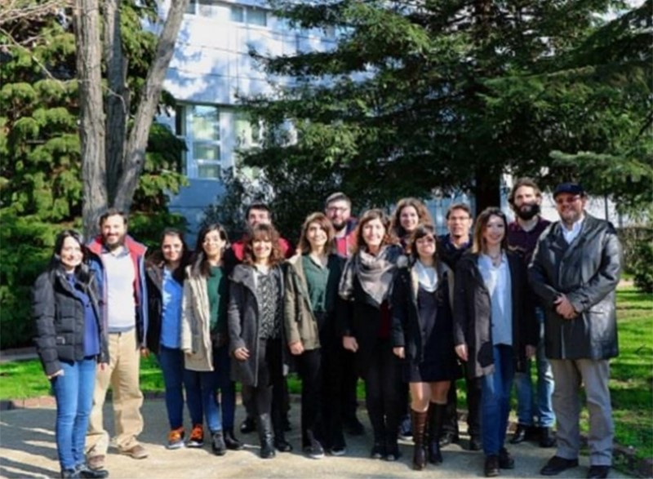
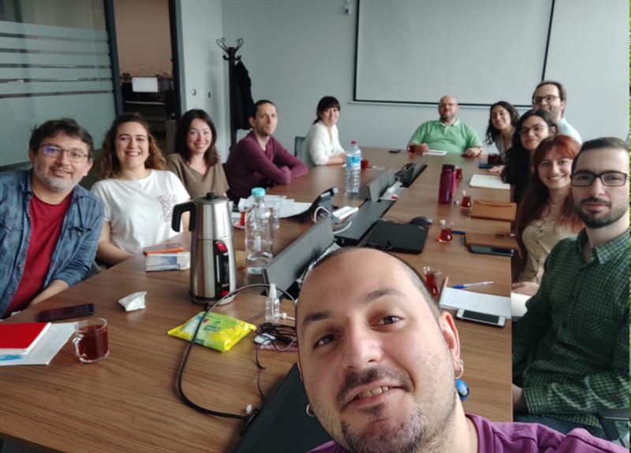
OUR TEAM
3

Slide 4

Preparatory Information on Our Research & Analytical Techniques/Instrumentation
SNG&HydTec Lab_Focus & Functions
Catalysts & Adsorbents_Preparation & Pretreatment Systems
Performance Test Systems
Analytical Techniques & Instrumentation
High Performance Computing & Quantum Mechanical Simulations
Support Systems
List of Routine & Investigative Analysis We Offer for Our Clients
The Procedure To Take Routine & Investigative Analysis Services from SNG&HydTec Lab
5
15
21
27
31
51
54
56
75
TABLE OF CONTENTS
4

Slide 5

PREPARATORY INFORMATION ON OUR RESEARCH & ANALYTICAL TECHNIQUES / INSTRUMENTATION
5

Slide 6
Thermodynamics
Will this reaction occur
If it occurs, what is the maximum conversion
Thermodynamics
Q&A
Kinetics
How fast the maximum conversion can be reached
Only temperature
What can increase the maximum conversion
What can increase the speed in reaching maximum conversion
Catalysis
6

Slide 7
It provides a new path for reaction
How a catalyst works
Solid (Heterogeneous)
What type of catalysts mostly used in industry
Why heterogeneous
To benefit from high temperature
Q&A
How a new path is provided
Catalyst has specific sites
What kind of sites
Sites that can interact with reactant(s)
So what?
Thus the new path has lower activation energy
7

Slide 8
Activity
Selectivity
Stability
What are the ultimate goals in heterogeneous catalysis
High -
Q&A
NO
Is it easy to design and develop an industrial catalyst
Clean energy & fuel production
Combating global warming
YES
Are catalytic technologies crucial in
8

Slide 9


EX SITU
Processes or experiments conducted outside of the natural or original environment.
IN SITU
A LITTLE TERMINOLOGY…
Processes or experiments conducted within the natural or original environment
OPERANDO
conducting measurements or analysis on a catalyst or material under realistic operating conditions, simultaneously with measuring its activity and stability in chemical reaction of interest.
9

Slide 10
RESEARCH CATALYST
Catalysts in powder form; research-only use
A LITTLE TERMINOLOGY…
TECHNICAL CATALYST
Catalysts in granular or pellet form; industrial and practical use
10

Slide 11
When little is known, empirical methods are preferred
Fundamental methods, which include computational chemistry, kinetic modeling and reactor design, focus on reaction mechanisms and engineering principles. Such methods are useful when mechanistic information and/or reactor constraints are available a priori.
Empirical methods include data-driven models that make no assumptions on reaction mechanism or the reactor configuration.
Computational
Chemistry
Statistical
Design of Experiments
Modeling Methods in Catalysis Research
Kinetic modeling
Data Analysis
Methods
Process
Design
Structure Performance Relationships
With more knowledge available, more fundamental methods become more important
Chem. Soc. Rev., 42 (2013) 6094-6112
11

Slide 12
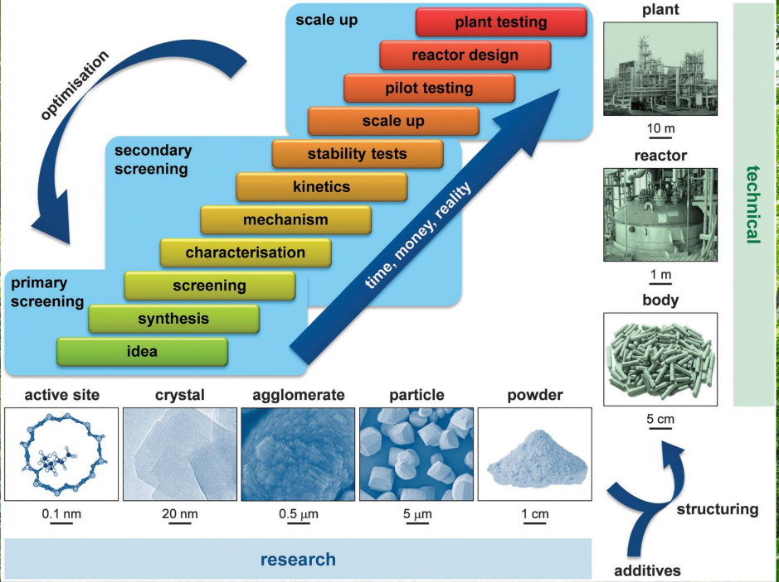
The key step of interactive catalyst development is the translation of a promising research catalyst into a technical catalyst involving the extrapolation of laboratory recipes to an industrial (practical) scale and the structuring of powders with additives into mm-sized bodies.
Successfully implemented technologies are those which deliver recognisable performance benefits upon bridging the multiple length scales from the active site to the chemical plant (i.e. practical use).
Chem. Soc. Rev., 42 (2013) 6094-6112
12

Slide 13
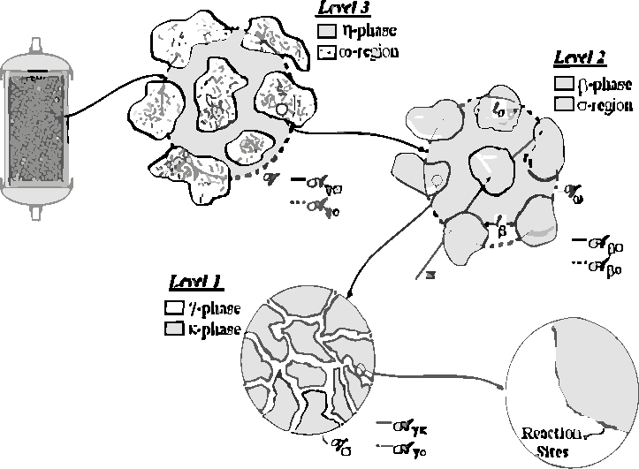
Reactor
Catalytic Reactor in
Industrial Plant
Active Site
Braz. J. Chem. Eng., 24 (2007) 47-60
13

Slide 14
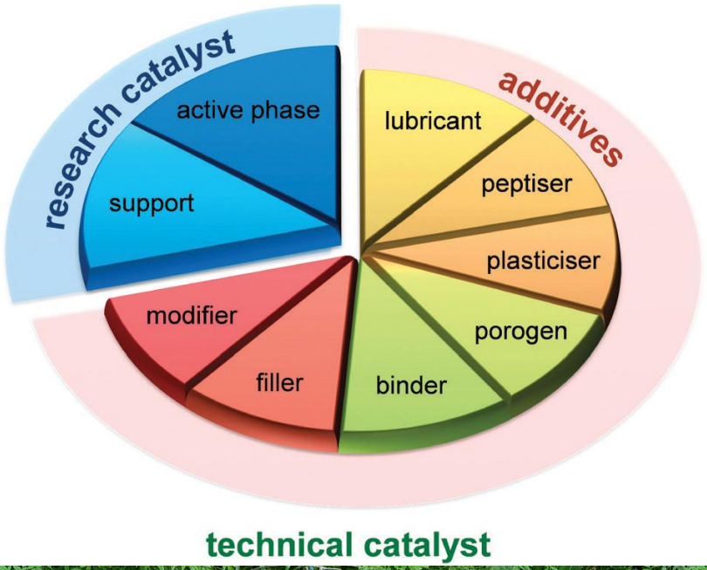
Chem. Soc. Rev., 42 (2013) 6094 -6112
14

Slide 15
SNG&HYDTEC LAB
FOCUS & FUNCTIONS
15

Slide 16

SNG&HydTec Lab is a laboratory focused on the design, development, characterization, and production of catalysts and adsorbents.
The primary objective of SNG&HydTec Lab is to conduct research and development (R&D) in the field of efficient, CO₂ emissions-free, or limited emission energy and fuel production. The lab aims to facilitate the transition from R&D to technology implementation. In addition to energy-related studies, the lab also focuses on various solid catalytic processes.
16

Slide 17

• Design and development of novel technical catalysts for the main catalytic processes of coal-to-natural gas (SNG) production technology
• Design and development of novel technical catalysts for the fuel processor (FP) to be used in PEM grade hydrogen production from widely distributed hydrocarbons (methane/bio-methane, LPG)
• Design and development of efficient and stable technical CO₂ adsorbents for preand post-combustion technologies, and for CO₂ adsorption from hydrogen rich streams
RESEARCH FOCUS
17

Slide 18
• Design and development of novel technical catalysts for the conversion of (captured) CO₂ into economically valuable products through dry (CDRM) and mixed (MRM) reforming reactions
• Design, optimization, and development of the state-of-the-art catalyst(s) required by the industry within the scope of joint projects
RESEARCH FOCUS (CONT’D)
18

Slide 19
SNG&HydTec Lab possesses the capability to transition from research catalysts to granular technical catalysts. This signifies its ability to progress from the research and development phase to actual technology production in the field of catalyst development.
SNG&HydTec Lab utilizes state-of-the-art characterization techniques, instrumentation and reaction systems enabling the establishment of structure-performance relationship for the catalysts through the use of operando analysis/testing.
WHAT WE DO
19

Slide 20
SNG&HydTec Lab uses its systems and instrumentation also in clients’ projects, not limited to the area of heterogeneous catalysis, to provide the most comprehensive solutions and reliable d﻿ata either they involve routine testing or investigative analysis.
WHAT WE DO
20

Slide 21
CATALYSTS & ADSORBENTS PREPARATION & PRETREATMENT SYSTEMS
21

Slide 22
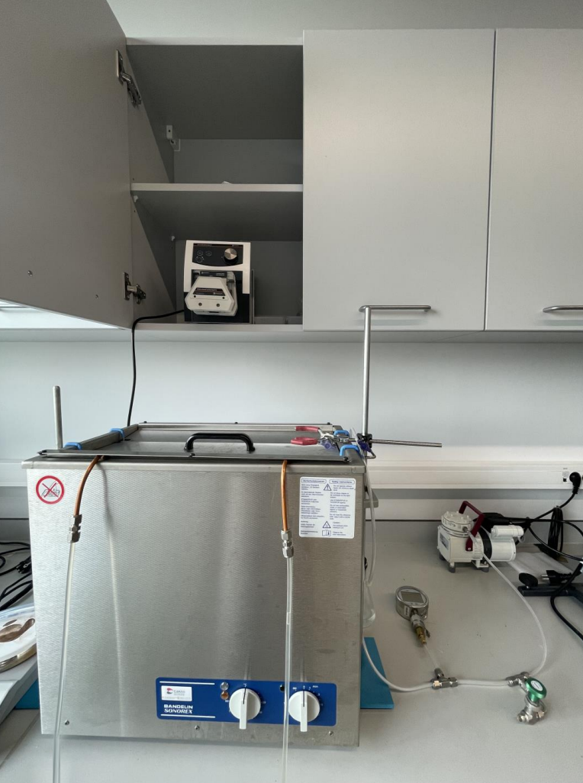
Catalyst Preparation Systems
• Impregnation
• Coprecipitation
• Deposition precipitation
• SBA preparation
• Controlled pH
• Sonicators/Ultrasonic Baths
• Shaker Baths
• Baths w/heating and cooling
...
22

Slide 23
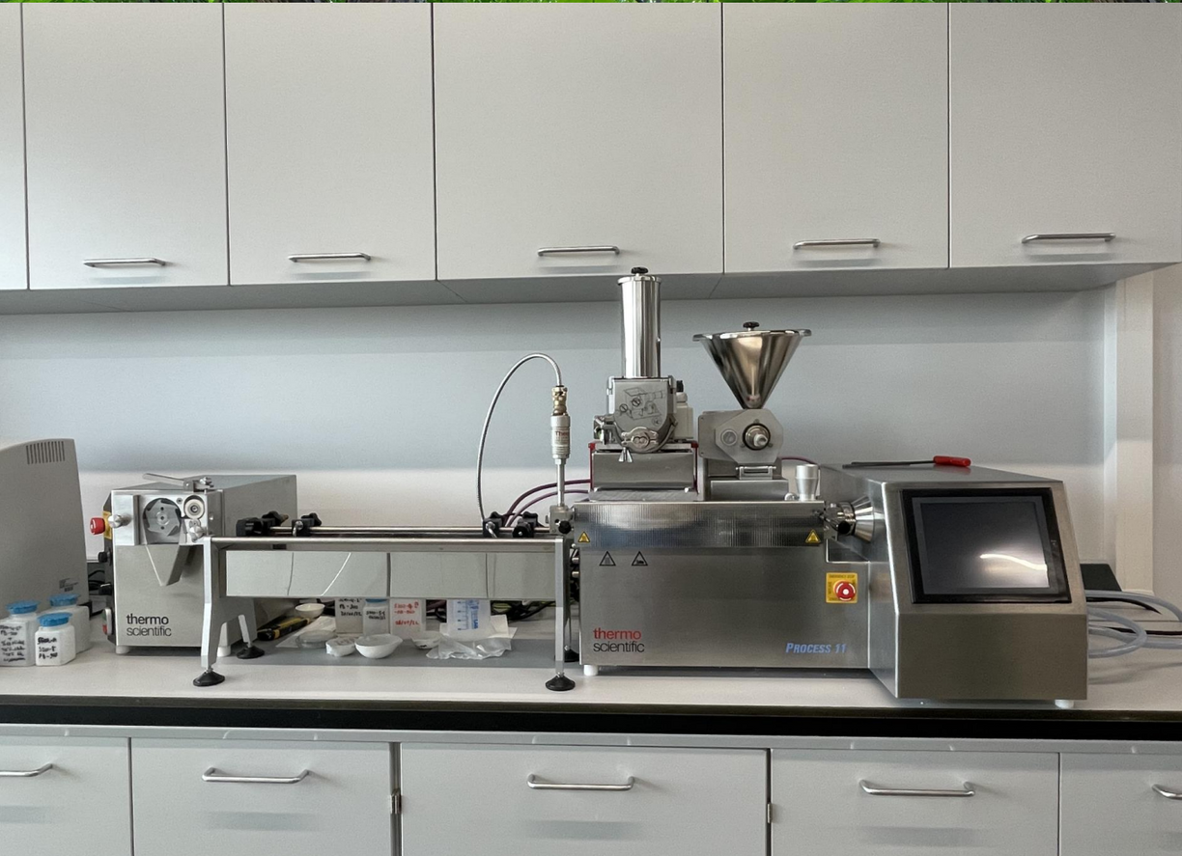
Twin Screw Mixer & Extruder
• ThermoFischer Scientific Process 11 w/
• Adder Liquid Barrel
• Cooling
• Sheet Die (30 mm)
• Volumetric RotoTube Feeder
• Gravimetric MiniTwin MT0
• Water Bath
• VariCut Pelletizer
23

Slide 24
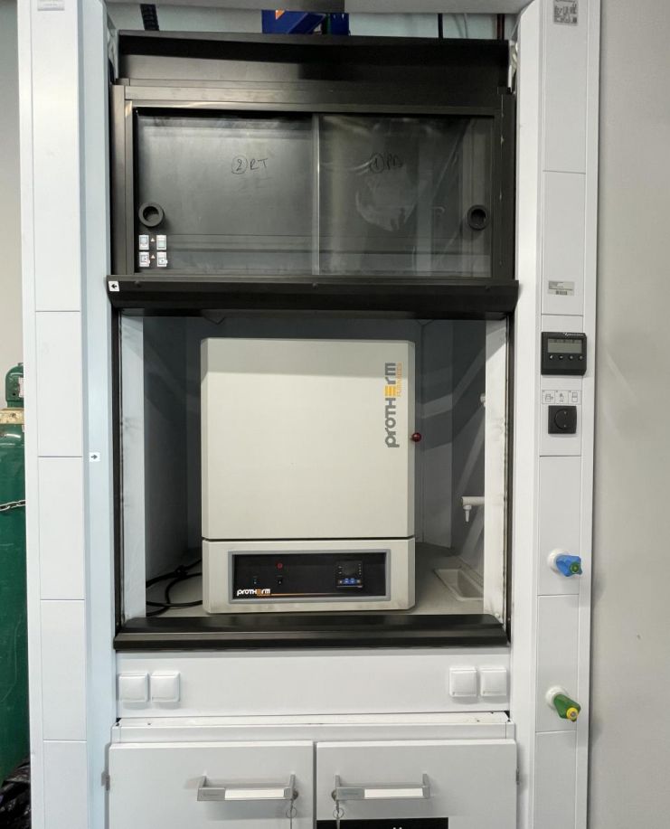
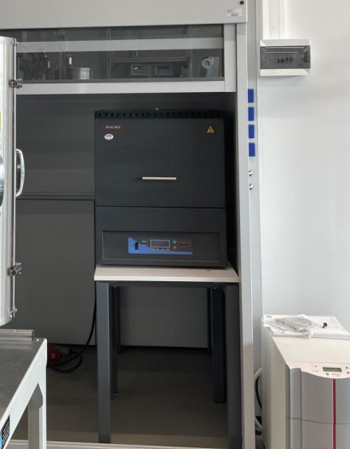
Static Ovens
1200 °C (x2)
1800 °C
...
24

Slide 25
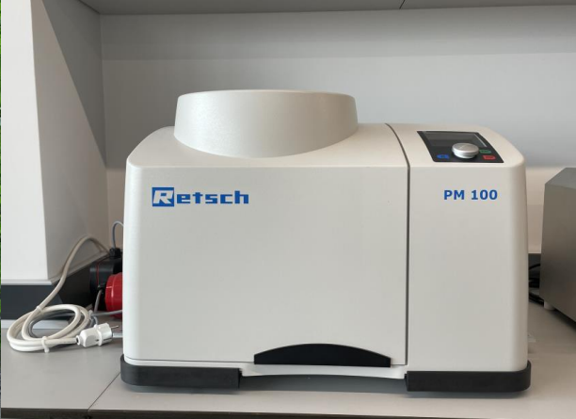
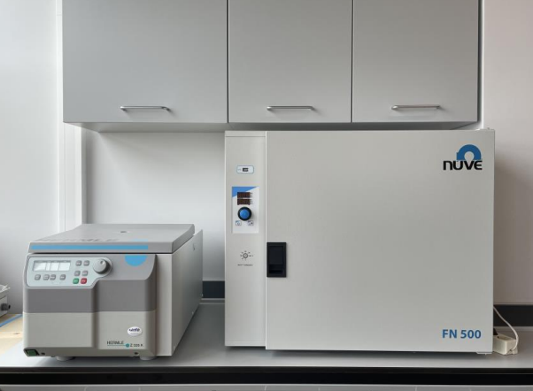
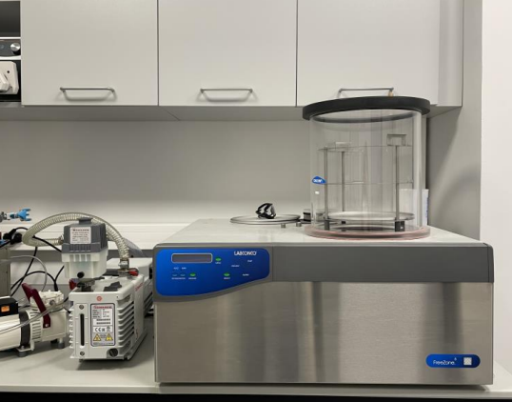
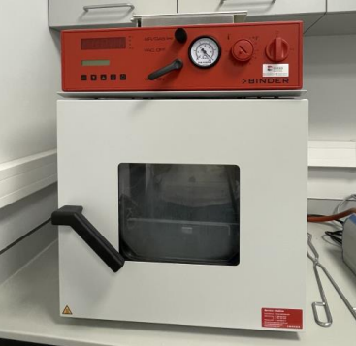
• Grinding and Sieving
• Sieve Shakers
• Ball Mill
• Centrifuge
• Vacuum Ovens
• Drying Ovens
• Freeze Dryer
...
25

Slide 26
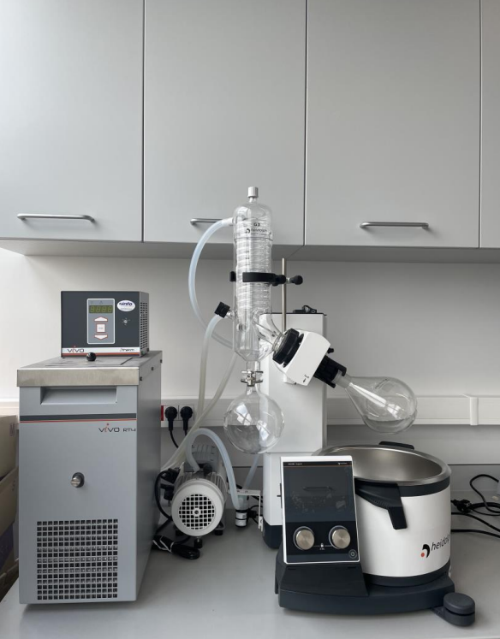
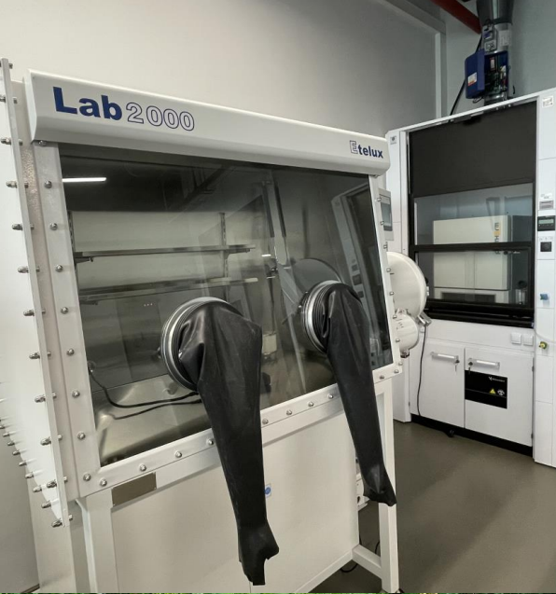
• Rotary Dryers
• Glove Box ….
26

Slide 27
PERFORMANCE TEST SYSTEMS
(Single and Serial Reactor Systems)
27

Slide 28
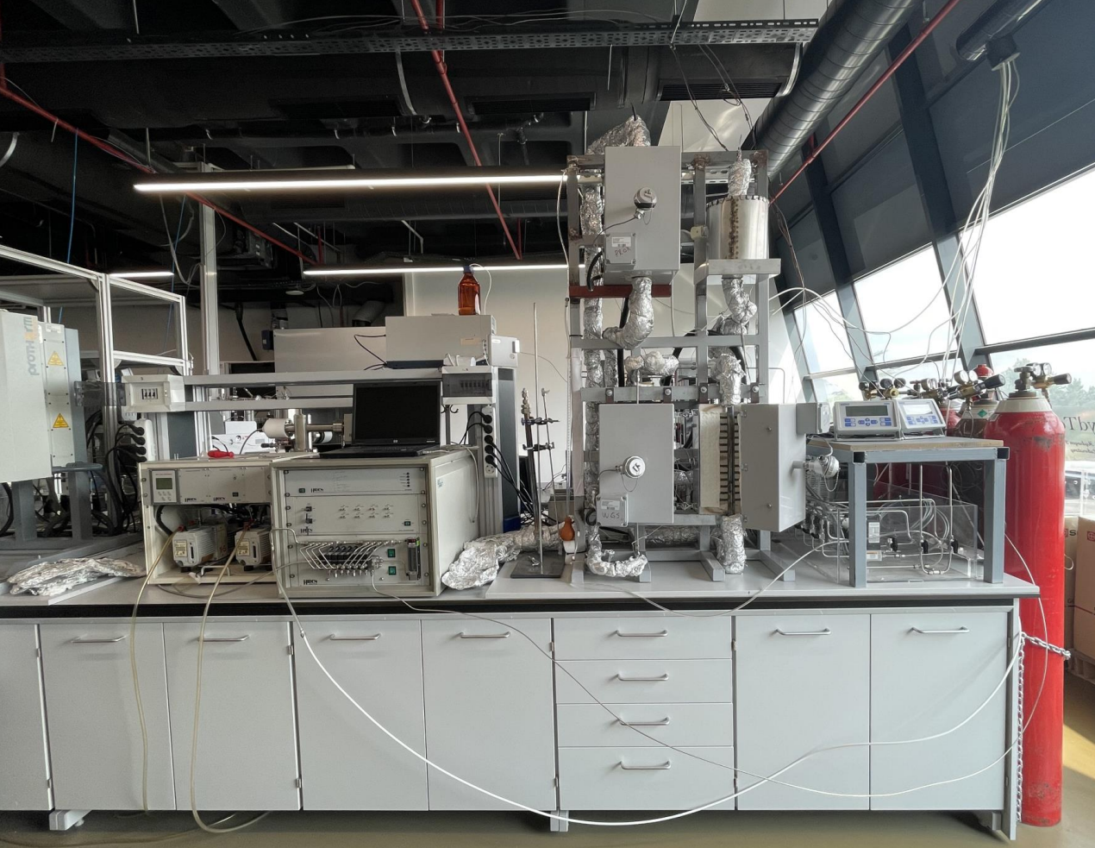
Fixed Bed Reactor Systems
(Atmospheric; Powder Catalyst -Differential)
• Single Reactor (x3)
•Two Reactors Serial - Parallel (x2)
• Three Reactors Serial - Parallel (x1)
Fixed Bed Reactor Systems
(Atmospheric; Granular Catalyst)
• Three Reactors Serial - Parallel (x1)
28

Slide 29
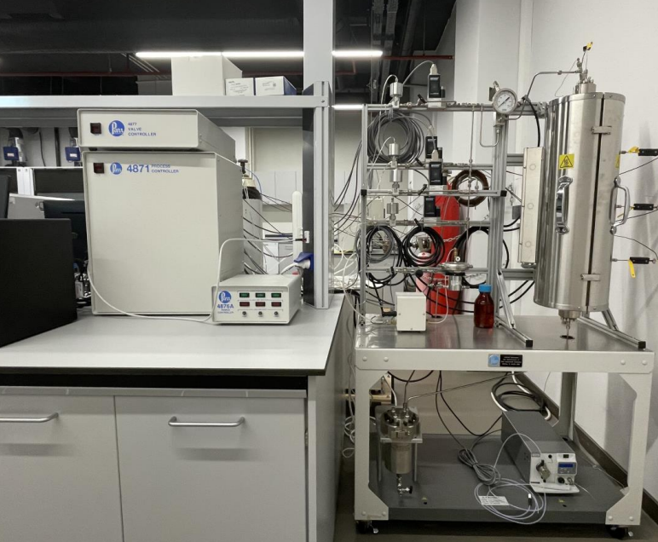
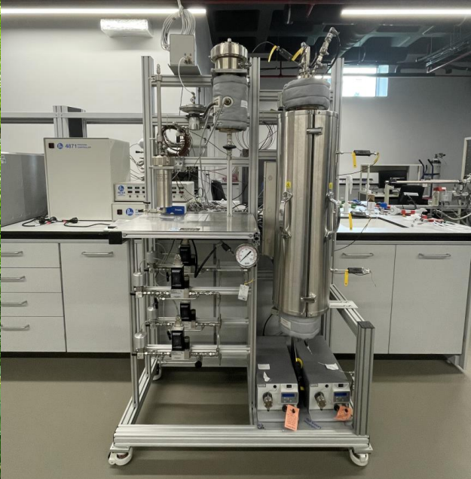
Fixed Bed Reactor Systems
(P up to 30 atm; powder or granular catalyst)
• Single Reactor (x2)
Fluidized Bed Reactor System
(P up to 30 atm; powder or granular catalyst)
• Single Reactor (x1)
29

Slide 30

EACH REACTOR SYSTEM CONSISTS OF
• A feeding block (MFCs, HPLC/syringe pump(s), heated valves & transfer lines)
• Reactor(s) in vertical oven(s) w/programmable temperature controller
• An analysis block (gas chromatograph(s) or mass spectrometer w/ directing manifold)
REACTOR SYSTEM
30

Slide 31
ANALYTICAL TECHNIQUES & INSTRUMENTATION (Modes: Ex situ, In situ, Operando)
31

Slide 32
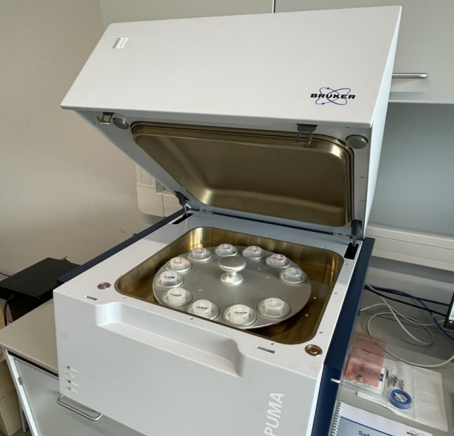
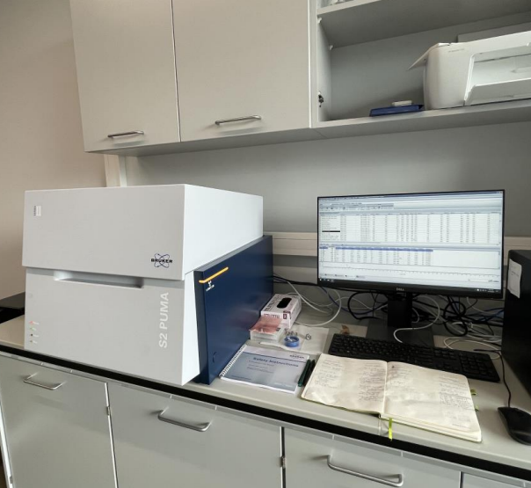
EDXRF_Energy -Dispersive X -ray Fluorescence
The system is a commercial product; Bruker S2 PUMA Series 2 – Carousel• Single Reactor (x2)
Analysis mode: ex situ
32

Slide 33

ANALYSIS EXAMPLE
• Elemental analysis of prepared or commercially available materials, support materials, catalysts, and adsorbents
• Determination of the metal loading(s) and/or elemental compositions of the obtained catalysts prepared through sequential or simultaneous wet impregnation, solution-type impregnation, co-precipitation, sol-gel method, etc., and analyzing their compatibility with (or deviations from) the targeted values
PARAMETRIC USE CASES
• Optimization of catalyst and adsorbent preparation methodology on the basis of minimization of the deviation of obtained metal loading from the targeted value
33

Slide 34
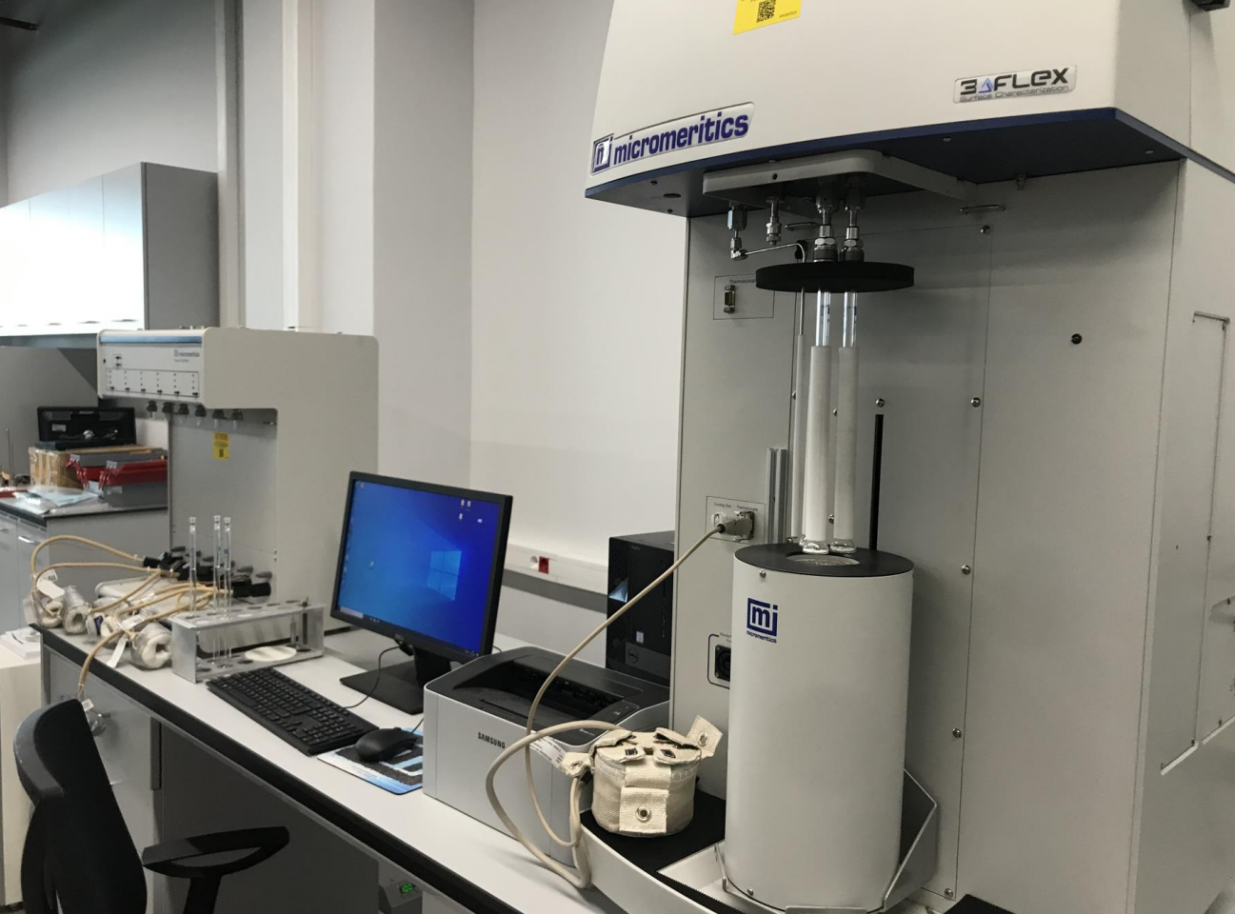
TSA -TPV -PVD -PSD Analysis System
The system is a commercial product; Micromeritics 3FLEX 3500 Multiport Chemisorption/ Physisorption/ Micropore Analyzer
Analysis Mode: Ex situ / In situ
34

Slide 35
ANALYSIS EXAMPLE
• Micro physical characterization of support materials, catalysts, adsorbents and all kinds of porous materials by
• Total surface area (TSA)
• Total pore volume (TPV)
• Pore volume distribution (PVD) / pore size distribution (PSD) analyses
• Determination of metal dispersion and metal surface area (MSA) of catalysts
PARAMETRIC USE CASES
• Investigating the changes in the physical properties (TSA, TPV, PVD, and PSD) of support materials, adsorbents, catalysts and porous materials under pretreatment and reaction conditions
• Optimization of catalyst, adsorbent and porous material preparation and pretreatment parameters/conditions on the basis of microphysical properties and/or performance (ex-situ)
• Stability analysis of microphysical characteristics of catalysts, adsorbents, supports and porous materials (ex situ)
35

Slide 36
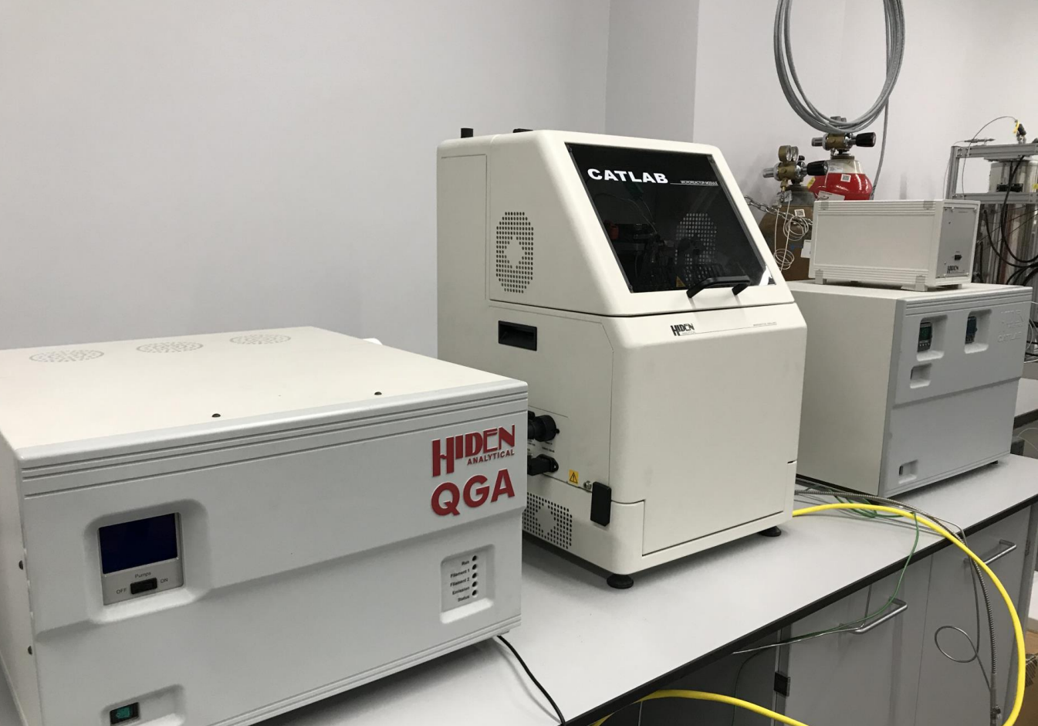
CATLAB
The system is a commercial product, which is a combined ‘zero dead volume’ micro - reactor mass spectrometer system for catalyst characterization with pulse chemisorption, by HIDEN.
Analysis Mode: In situ
36

Slide 37

• CATLAB is suitable for performing TAP (Temporal Analysis of Products) experiments as its microreactor is designed to enable the precise control of gas-phase reactions, while the connected mass spectrometer allows for the real-time measurement of products and reactants
• The real-time measurement of reactants and products using mass spectrometry allows researchers to study transient kinetics, mechanistic aspects and reaction intermediates of catalytic reaction
CATLAB
37

Slide 38

ANALYSIS EXAMPLE
• Obtaining TPR (Temperature Programmed Reduction) and TPO (Temperature Programmed Oxidation) profiles of catalysts
• Determination of adsorption isotherms, metal dispersion and surface acidity
• Reaction testing with simultaneous multicomponent product measurement
• Investigation of kinetic and mechanistic aspects of catalytic reactions; transient kinetics studies
PARAMETRIC USE CASES
• Optimization of preparation parameters/levels used in the preparation of catalysts, including number of serial impregnation cycles, intermediate and final drying process(es), intermediate and final calcination process(es), and reduction process and parameter levels, based on the level of metal distribution
38

Slide 39
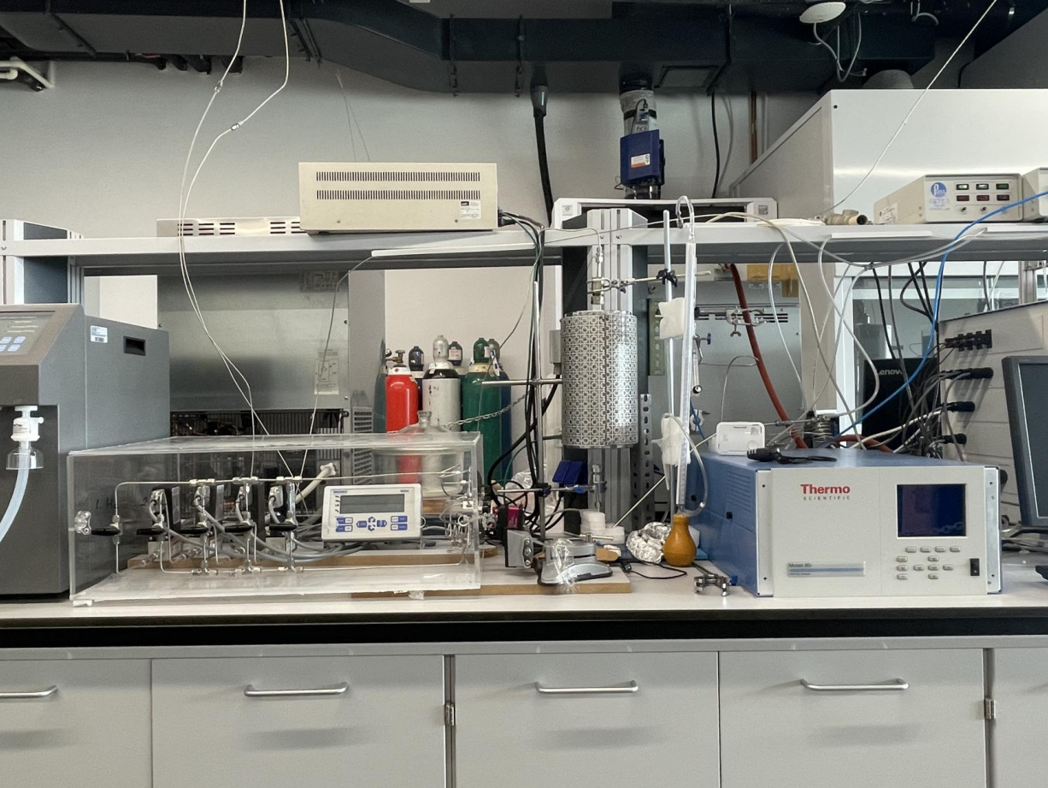
Dynamic CO Adsorption System
The system is specifically designed and constructed by our group for determination of metal dispersion on especially highly loaded Ni & Co - based catalysts.
• Feed block MFCs and sampling valve • Quartz reactor placed in vertical oven with precise programmable temperature control
• Analysis block Thermo Scientific NDIR Multi analyser 60i
Analysis Mode: In situ
39

Slide 40
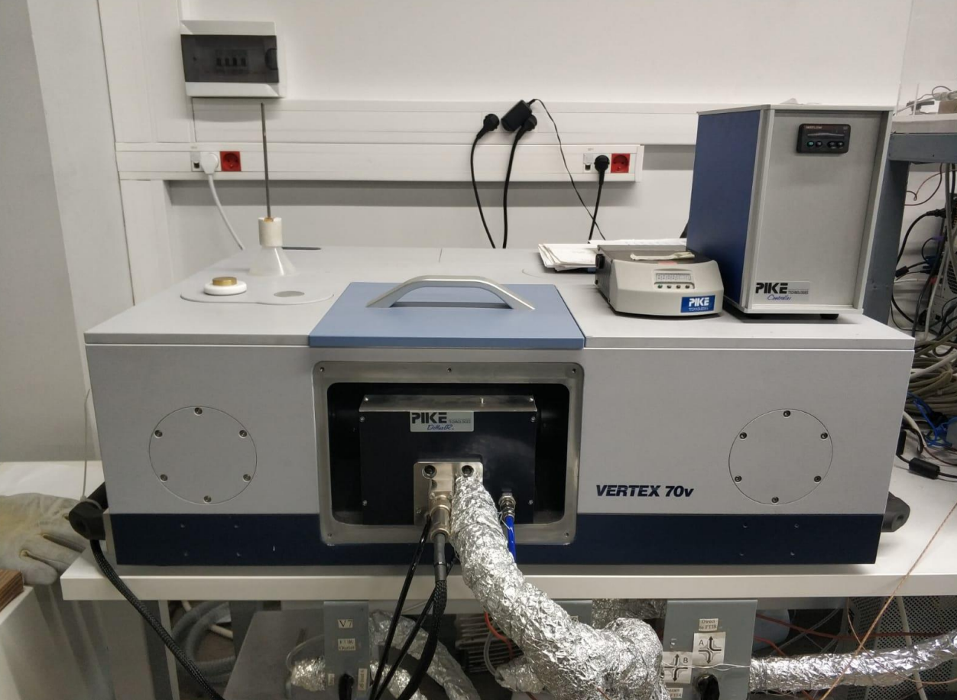
FTIR_Bruker VERTEX 70v
• Detector: MCT
• Equipped with PIKE Diffuse IR
▫ Diffuse IR- 1_P from vacuum up to 1 bar, T: from 25°C up to 900°C
▫ Diffuse IR - 2_P from vacuum up to 1 bar, T: from 25°C up to 500°C
▫ Reaction cell w/ZnSe window
▫ Reaction and/or heat treatment under vacuum, in air or under the flow of wet or dry gas mixtures having desired composition and pressure
40

Slide 41
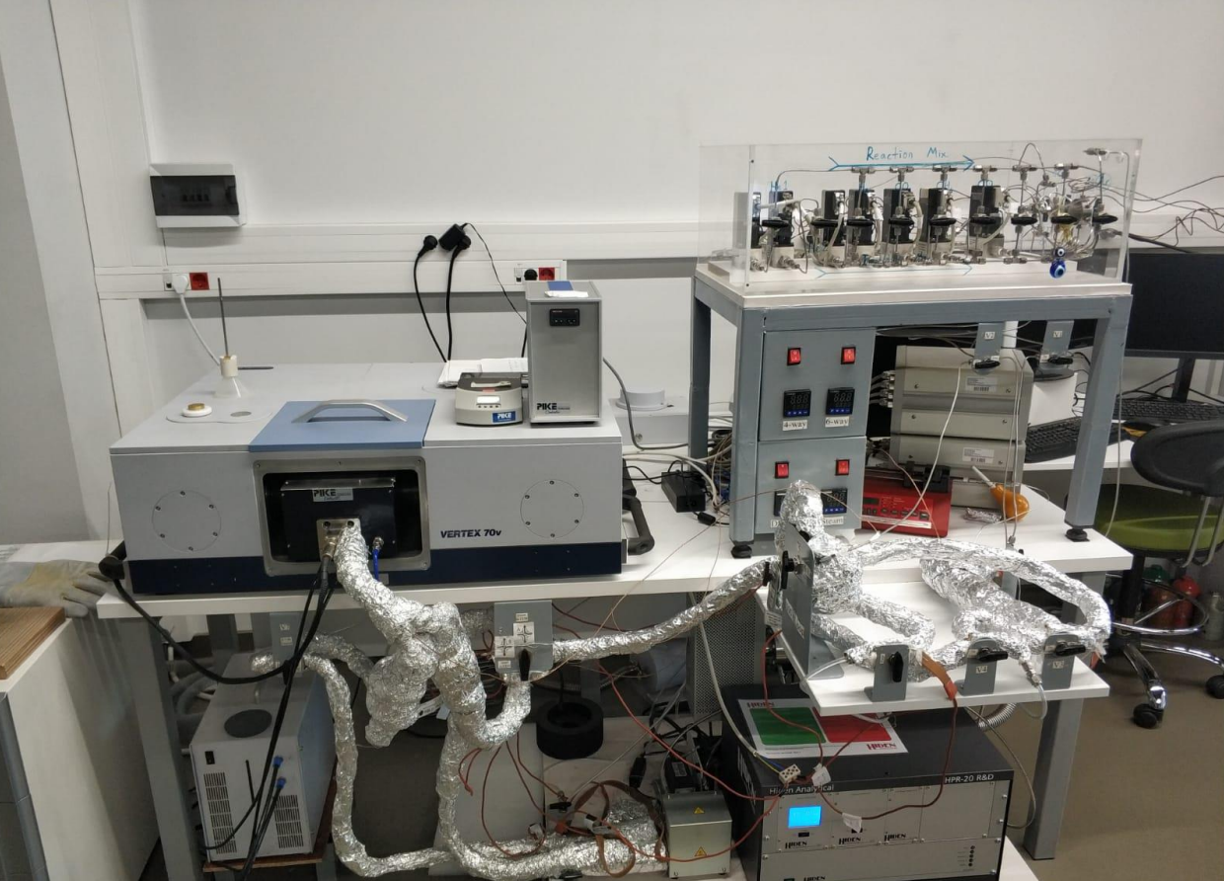
FTIR-DRIFTS-MS System_Components
• Feed block MFCs, HPLC/syringe pumps, heated valves & sampling valves & transfer lines
• Bruker Vertex 70v FTIR with PIKE DRIFTS w/ reaction cell
• Analysis block Mass spectrometer & switching manifold
Analysis Mode: In situ / Operando
41

Slide 42
ANALYSIS EXAMPLE
• Mechanistic investigation of adsorption and surface reactions under operando conditions
• Determination of surface interactions during thermal pretreatments (calcination/reduction) under in situ conditions
• Operando transient-kinetic studies
• Testing aimed at obtaining mechanistic reaction equations
EXAMPLES OF PARAMETRIC USE
• Investigation of changes induced by catalyst metal loading, pretreatments, and/or metal distribution on surface adsorption properties and surface reaction mechanisms
42

Slide 43
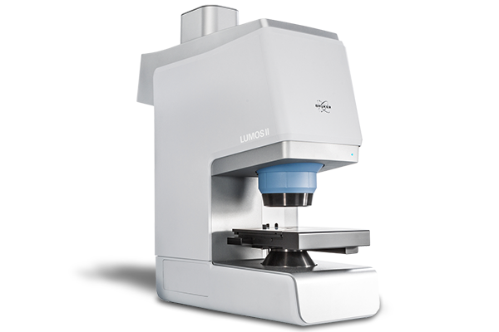
FTIR Imaging Microscope – LUMOS II
High-sensitivity TE-MCT detector
FTIR imaging in ATR, transmission and reflection modes
Conveniently handles samples up to 40 mm thickness
More than 550 spectra per second at 4 cm⁻¹ spectral resolution
43

Slide 44
ANALYSIS EXAMPLE
Identification and characterization of polymer materials, including determination of polymer blends and detection of additives or contaminants.
Analysis of pharmaceutical compounds to ensure proper formulation, identify contaminants, and verify the chemical composition of active pharmaceutical ingredients (APIs).
Examination of trace evidence such as fibers, paints, and residues to support criminal investigations and legal proceedings.
Analysis of coatings, films, and surface treatments to evaluate their composition, uniformity, and adherence.
Analysis of automotive parts and materials, including identification of polymers, composites, and surface contaminants.
Characterization of electronic components, including the identification of materials used in semiconductors, printed circuit boards, and other electronic devices.
Identification of minerals and characterization of geological samples to understand their composition and formation processes.
44

Slide 45
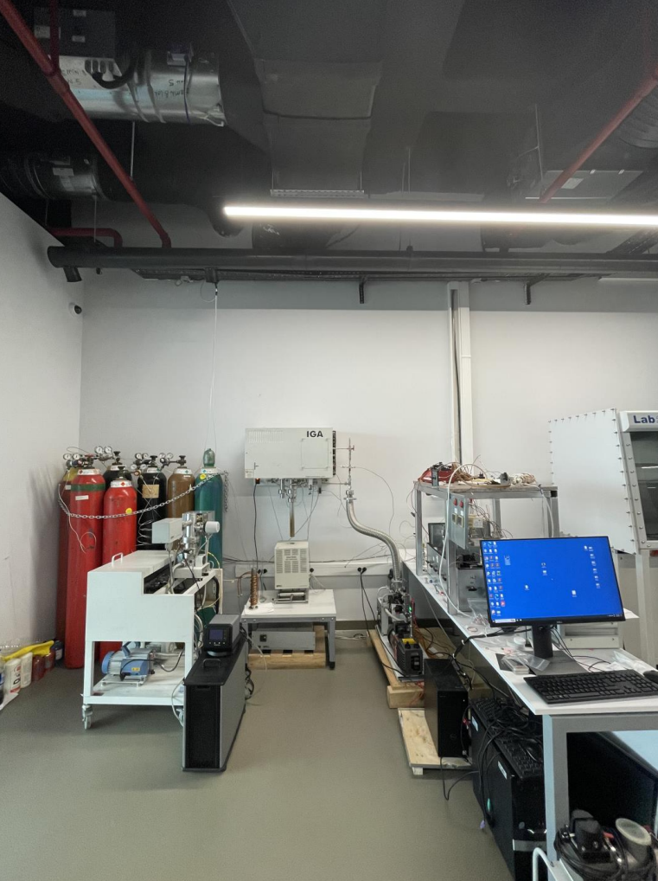
Gravimetric Analyzer -Mass Spec (IGA -MS) System
System Components
• Feed block MFCs, HPLC/syringe pumps, heated valves & transfer lines
• Gravimetric Analyzer Intelligent Gravimetric Analyzer -IGA by HIDEN
• Analysis block Mass spectrometer
Analysis mode: in situ/operando
45

Slide 46
ANALYSIS EXAMPLE
• Determination of adsorption properties and capacities of adsorbents as a function of pressure, temperature and (wet or dry) gas mixture composition (under the flow of gas mixtures having desired composition)
• Determination of adsorption enthalpy of gases on adsorbents
• Determination of selective adsorption properties of adsorbents and surface mole fraction of each adsorbate on adsorbent as a fn. of total pressure and temperature for wet or dry gas mixtures of desired composition
• Adsorption kinetics of gas(es) on adsorbents (for individual gas or wet gas mixture of desired composition)
• Determination of oxygen storage capacities of catalysts and adsorbents
PARAMETRIC USE CASES
• Optimization of preparation and pre-heat treatment method and parameters
• Optimization of adsorption properties of adsorbents and solid porous materials
• Establishing relation between adsorption –especially oxygen storage capacities- properties and performance of the catalysts'
46

Slide 47
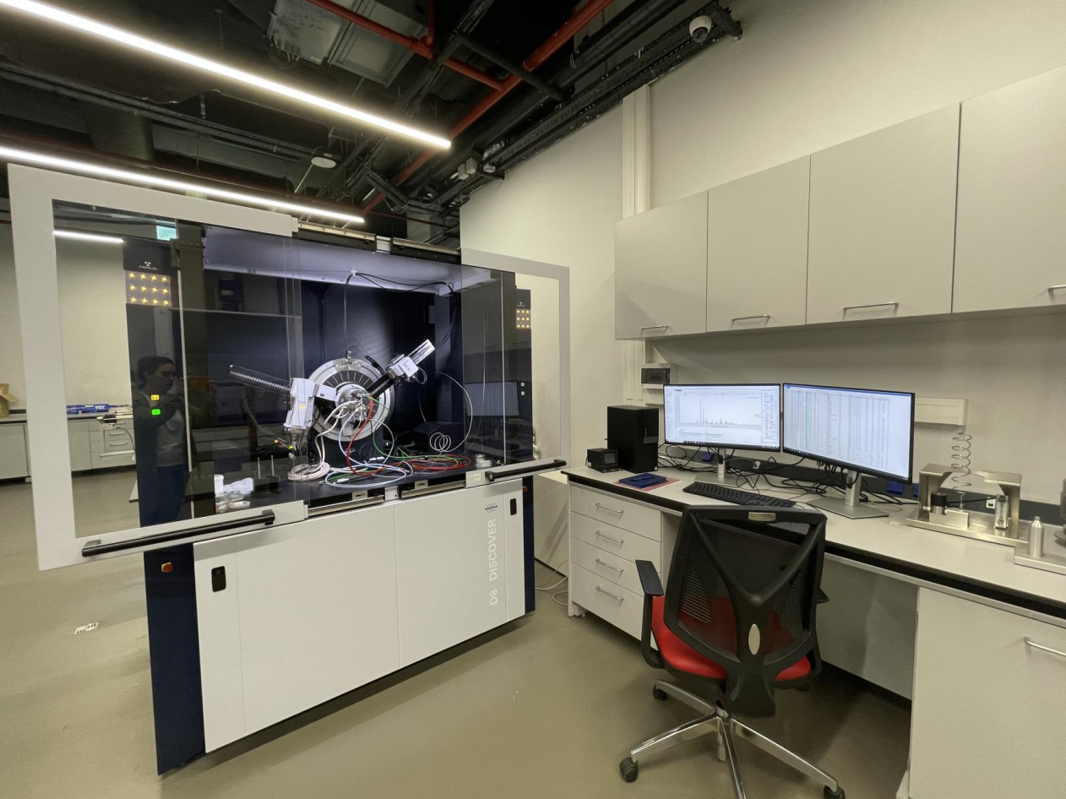
XRD_Bruker D8 DISCOVER
• X -Ray Sources: Cu and Mo
• Equipped with high -temperature /pressure reaction chambers for solid state and solid state -gas reactions
Chamber 1_ Anton Paar XRK 900, P up to 10 bars, T: from 25°C up to 900°C
Chamber 2_Anton Paar HPC 900, P up to 100 bars, T: from 25°C up to 900°C
Reaction and/or heat treatment under vacuum, in air or under the flow of gas mixtures having desired composition and pressure
47

Slide 48
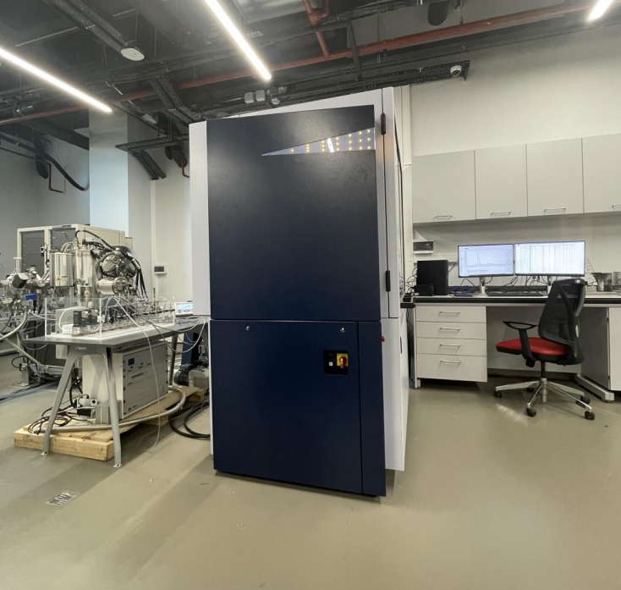
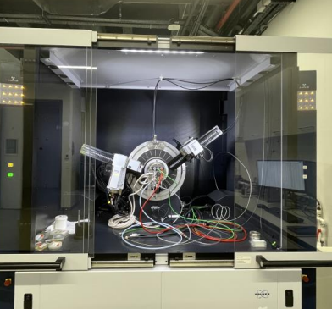
XRD System_Components
• Feed block MFCs, sampling valves and valves, transfer lines
• XRD_Bruker D8 DISCOVER
• Analysis block Mass spectrometer and switching manifold
Analysis mode: in situ/operando
48

Slide 49
ANALYSIS EXAMPLE
(Under vacuum, in air or under the flow of gas mixtures having desired composition)
• Determination of catalyst and support crystal structures and phase transition temperatures
• Determination of average size of dominant crystal structure
• Investigation of intermetallic alloy formation
PARAMETRIC USE CASES
• Determination of (active) crystal structures of catalysts and support materials, and their changes during catalyst pre-treatment (calcination, reduction) through TPO and TPR under operando conditions; matching crystal transitions with H₂ and O₂ consumption (peaks) during TPR and TPO, respectively
• Determination of changes occurring in crystal structure of the catalysts (and solids) during reaction (or in reactive environments) in response to conditions applied (feed gas mixture composition, temperature, etc.); determination of the effects of these changes on the catalyst's performance (activity, selectivity) under operando conditions
• Determination of phase transition temperatures of solid materials under different environments (gas compositions) and temperature under in situ conditions
49

Slide 50
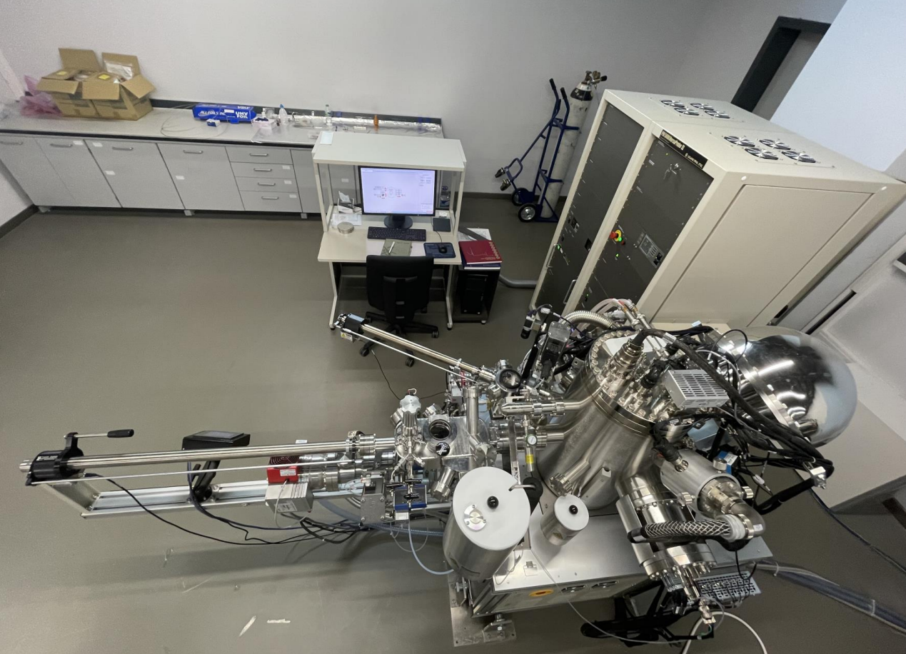
XPS_PHI 5000 VersaProbe III Scanning ESCA Microprobe
• Scanning AUGER (< 100 nm), SEM/SXI for elemental composition and chemical mapping
• High /low temperature ( -140°C to 600 °C) stage • Heating sample holder (up to 800°C)
• High Pressure reactor operating under flow of gas mixtures having desired composition (on prep arm )
The gas reactor has the H/C platen with heating to 800°C in static mode (1bar) or in vacuum, and up to 500°C with continuous gas flow at maximum pressure of 2 bars
50

Slide 51
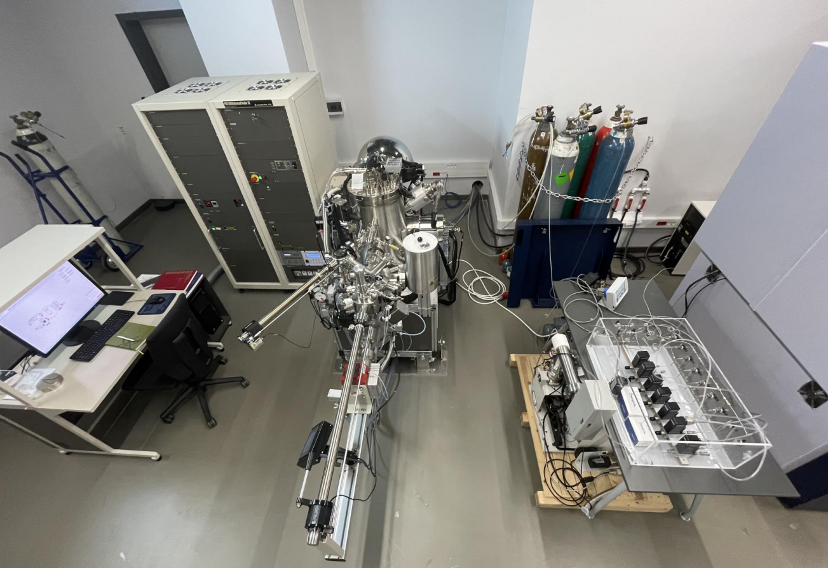
XPS System_Components
• Feed block MFCs, sampling valves& valves, transfer lines
• XPS_PHI 5000 VersaProbe III Scanning ESCA Microprobe
• Analysis block Mass spectrometer and switching manifold
Analysis Mode: In situ/semi-operando
51

Slide 52
ANALYSIS EXAMPLE
• Determination of electronic properties/oxidation levels of metallic active sites of catalysts, adsorbents, supports and materials
• Determination of surface concentrations of materials; investigation of changes in concentration along a line on the surface and with depth into the material/particle (depth profiling)
PARAMETRIC USE CASES
• The investigation of changes on the electronic properties/oxidation states of metallic active sites, support materials, solid materials during in situ pre-treatment (calcination, reduction) and specific gas-phase reactions depending on conditions applied (such as feed gas mixture composition, temperature and pressure)
• Semi-operando investigation of the effects of changes in the electronic properties/oxidation states of active metal(lic) sites of the catalyst on its performance (activity, selectivity) to establish structure-activity relation
52

Slide 53
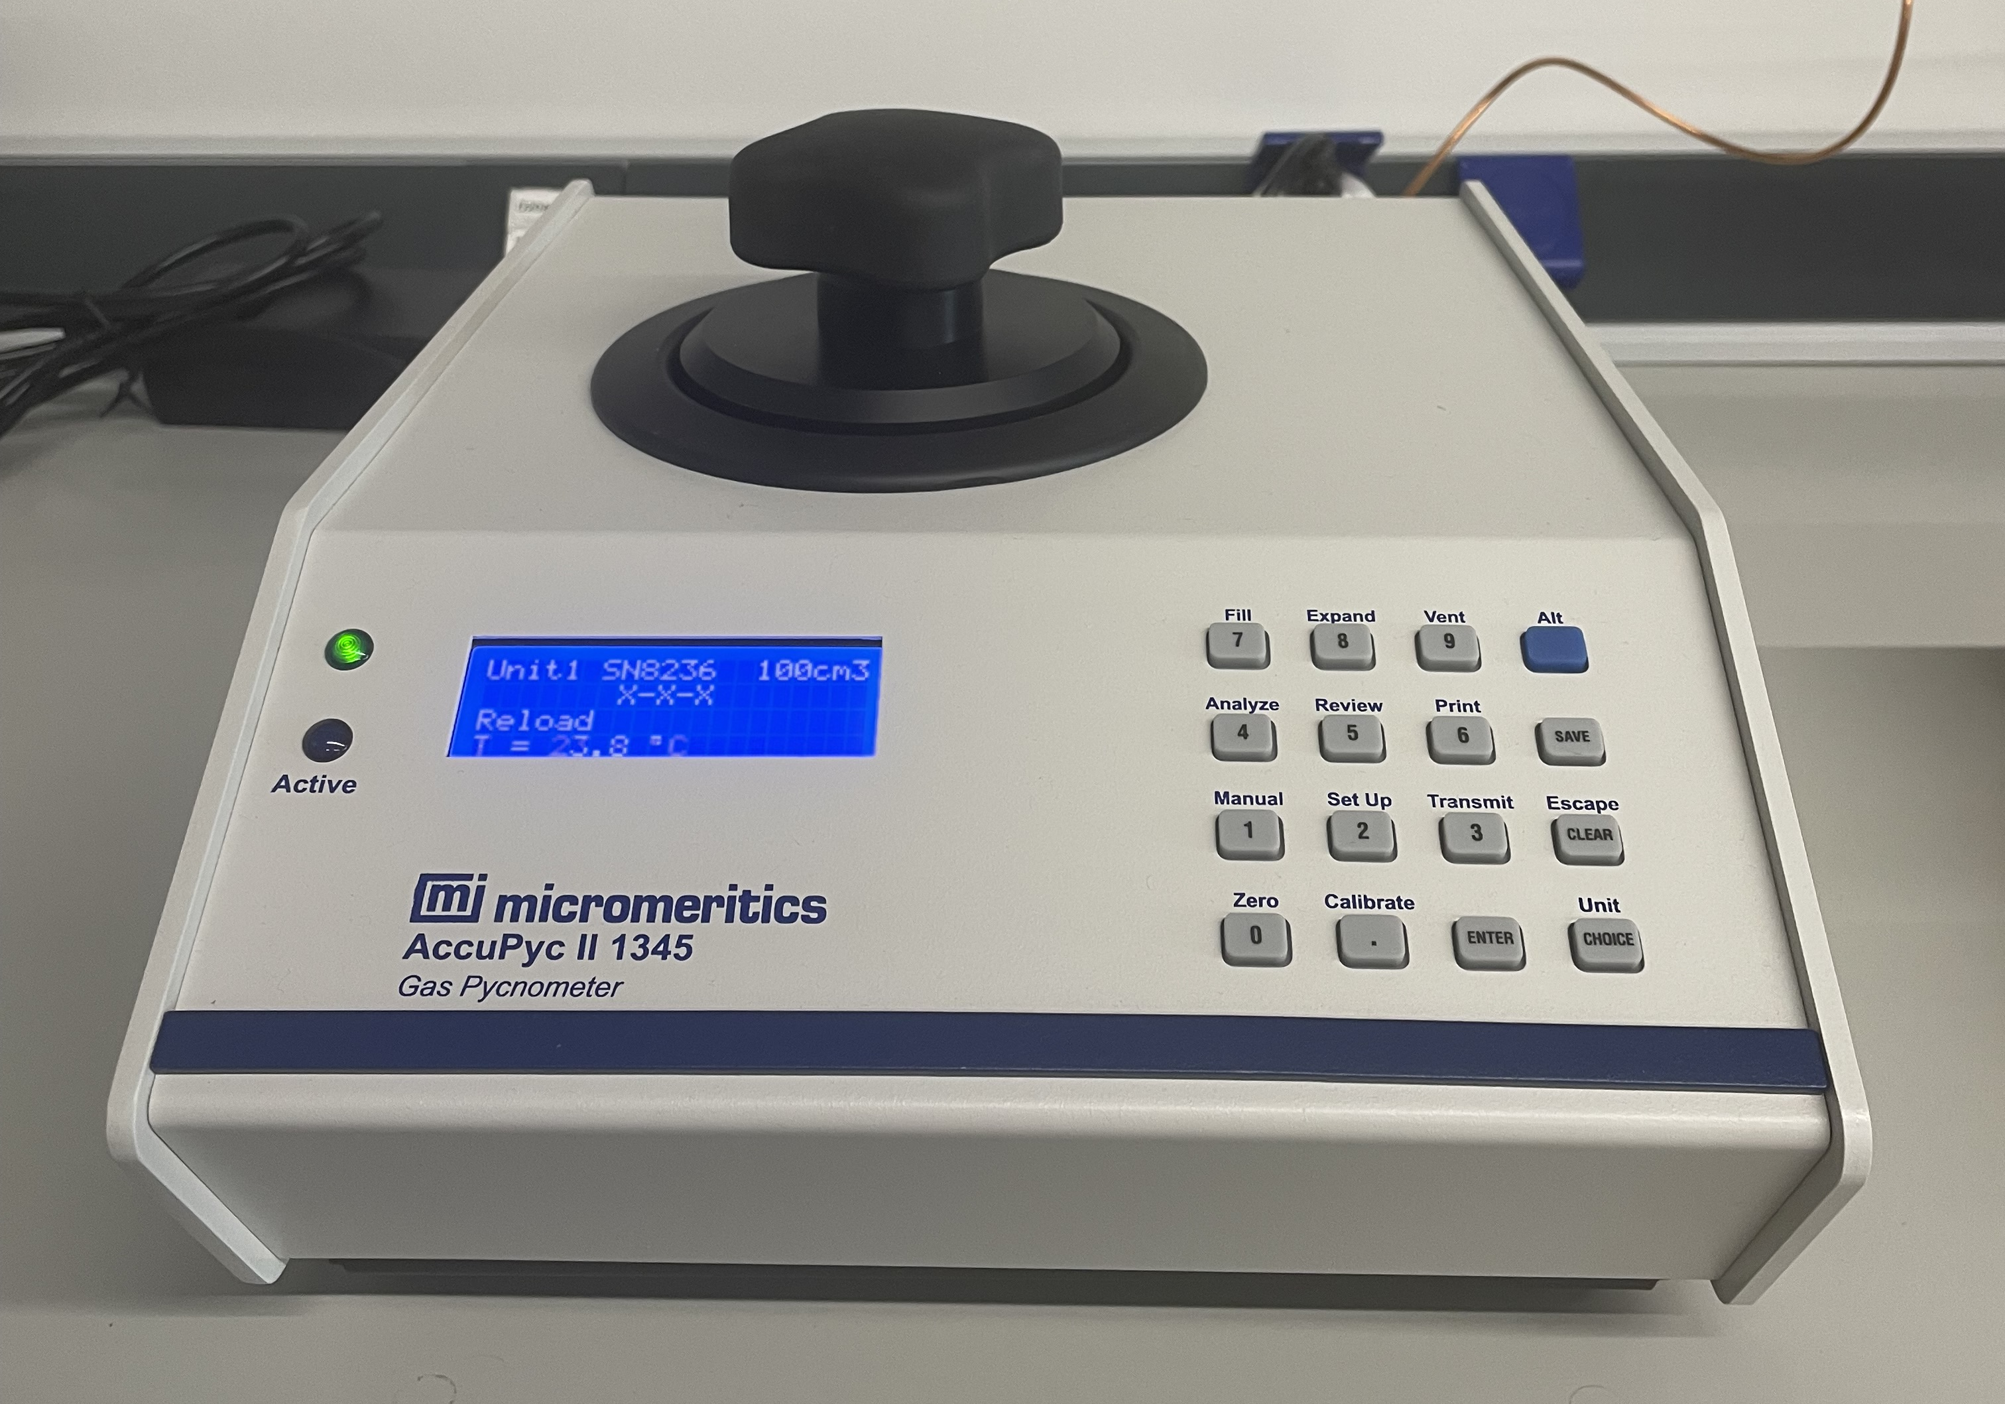
Automatic Gas Pycnometer - Micromeritics AccuPyc II 1345
The system is a commercial product.
High-precision volume measurements
True density calcualations for solid, powder and granular samples via gas displacement method using He
Certification of calibration for balls used by Prcision Bal & Gage Co.
53

Slide 54
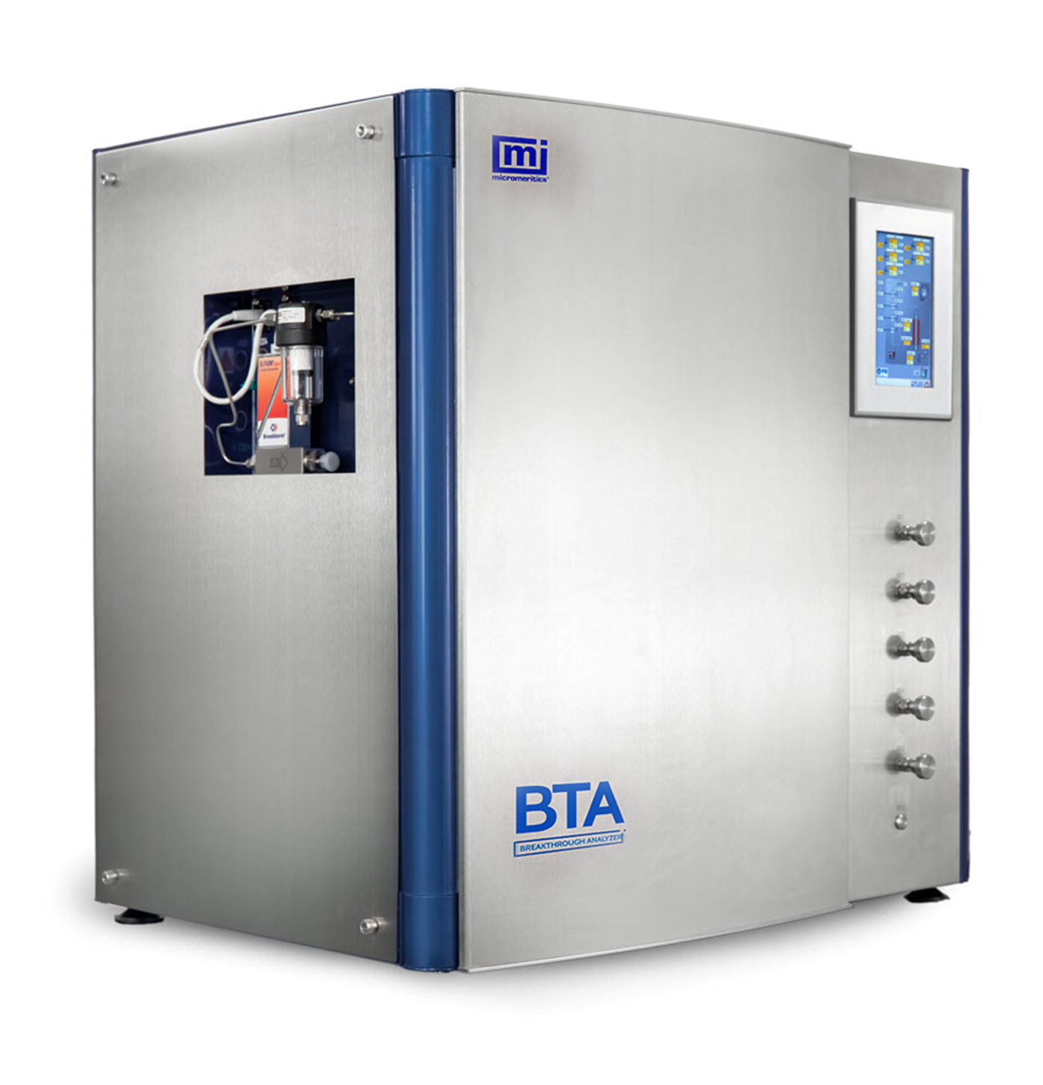
Breakthrough Analyzer - BTA
System Components
Feed block MFCs up to 30 bar in thermostated environmental chamber up to 150 °C
External vapor generator, up to 30 bar, 80 °C
Patented “No Dead Volume” mixing valve with rapid switching
In-situ vacuum preparation
Analysis block Mass spectrometer
Analysis Mode: In situ
54

Slide 55
ANALYSIS EXAMPLE
Determination of breakthrough curves for adsorbents
Dynamic single- and multi-component gas adsorption and desorption for adsorbents from 1 to 30 bar and from room temperature to 450 °C
Investigation of kinetic performance of adsorbents
Determination of heat of adsorption
Temperature programmed desorption up to 450 °C
PARAMETRIC USE CASES
Investigation of pure and selective gas adsorption characteristics for adsorbents and solid porous materials by evaluating the effects of preparation, pre-treatment and temperature.
Investigation of adsorption kinetics and optimizing adsorption and desorption times for PSA, TSA and VSA units.
Investigation of heat of adsorption via adsorption experiments at different temperatures.
55

Slide 56
HIGH PERFORMANCE COMPUTING/ QUANTUM MECHANICAL SIMULATIONS
56

Slide 57
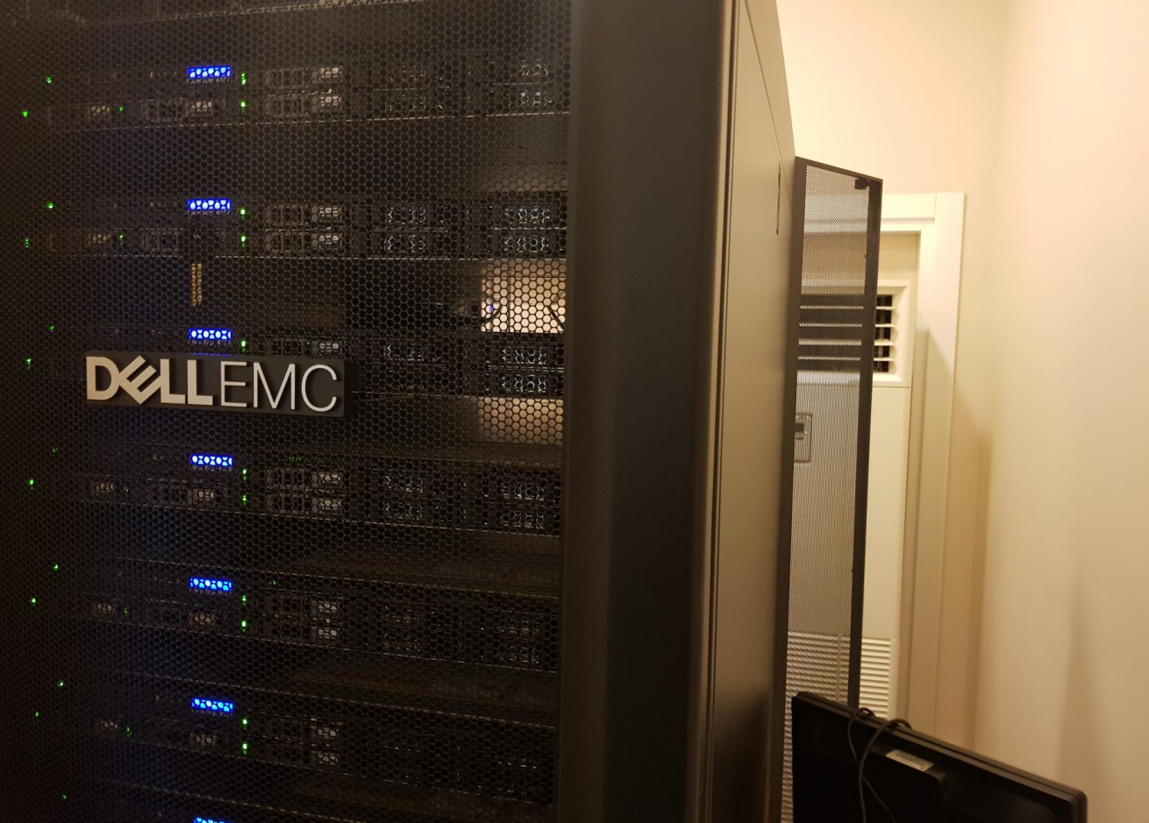
System
•Servers (x7)
•Main storage unit
• (12x960 GTB & 12x1.2 TB)
QM simulation codes
•5xBIOVIA MS Academic Standard
• 5xBIOVIA MS Academic Standard Quantum
•1x BIOVIA MS Academic
• Standard Classical & Mesoscale
• MATLAB & FLUENT
57

Slide 58
SIMULATION EXAMPLES
• Quantum mechanical simulation studies of adsorption/co-adsorption and reaction(s) on the active sites (and/or potential active surface sites) of the tested/developed/used catalysts either designed, developed and tested by our lab or mentioned in the literature
• Derivation/validation of mechanistic kinetic expressions
• Mathematical/CFD modelling and simulation of reactors
58

Slide 59
SUPPORT SYSTEMS
59

Slide 60
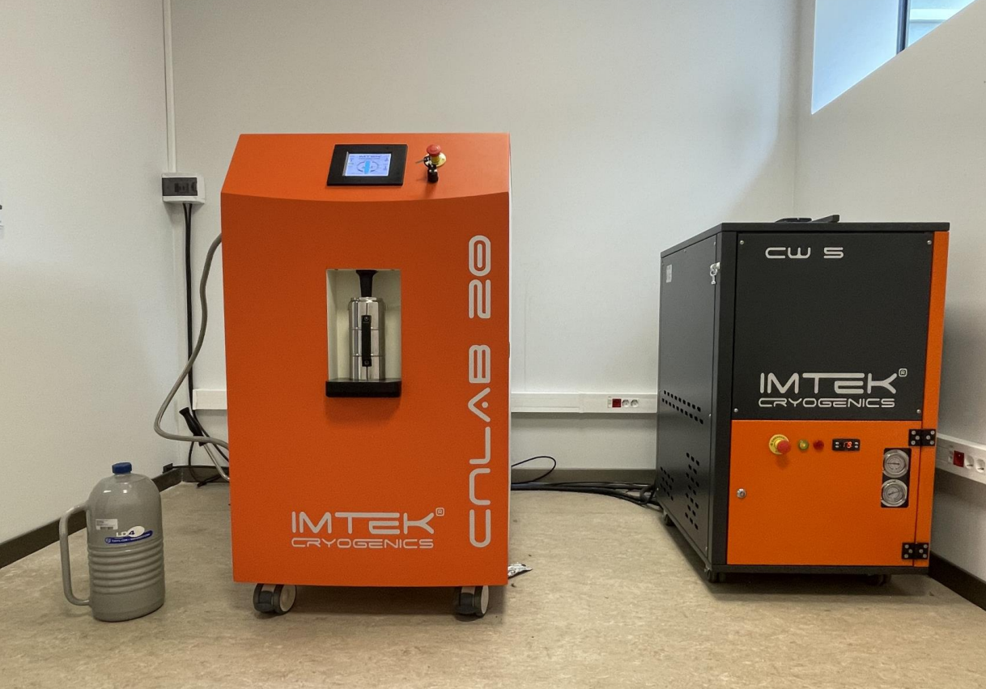
Liquid N2 -Generator
Capacity: 20 Lt/day
60

Slide 61

LIST OF ROUTINE AND INVESTIGATIVE ANALYSIS SERVICES WE OFFER FOR OUR CLIENTS*
*The lab's analysis spectrum encompasses a wide range of services, including but not limited to the following list. For especially non-routine/investigative analysis options, which should be tailored to your project's specific needs, we encourage you to consult with Dr. Burcu Selen Çağlayan for personalized assistance.
61

Slide 62
ROUTINE ANALYSIS
A systematic and regular examination of samples or data in a consistent manner. It often involves the use of established protocols, methodologies, or instruments to collect and analyze data.
A LITTLE TERMINOLOGY…
INVESTIGATIVE ANALYSIS
the process of conducting experiments and applying analytical techniques to investigate scientific phenomena, solve research questions, or explore new knowledge. It is conducted using specialized instruments and methods tailored to the specific research field. It requires scientific expertise, critical thinking, and proficiency in analytical methods.
62

Slide 63
We perform tailored routine and investigative analyses that meet the specific requirements of our clients' projects.
63

Slide 64
• In SNG&HydTec Lab, we believe that being well-informed about the sample's description, its preparation, the type of process or procedure it has been exposed to, and the client's problem related to it is the most crucial initial step in the analysis process
• In both routine and investigative analyses, especially for the latter, we be in good contact with the client throughout the project, be in collaboration and working with whenever necessary, examine the obtained data with the client at every step, and change the approach/methodology in case of unexpected results
64

Slide 65
• Preparation of Granular Catalyst Support Materials in Desired Particle Size*
• Preparation of Catalyst Support Material by Co-Precipitation*
• Addition of Metal(s) by Wet/Dry Impregnation*
• Drying at Atmospheric Conditions up to 110°C
• Drying under Vacuum up to 200°C using Vacuum Oven
• Freeze Drying down to -50°C using Lyophilizer (Freeze Dryer)
• Drying using Rotary Evaporator
• Calcination at Atmospheric Conditions (under Air) up to 1800°C
• Calcination under N₂ (inert) Flow up to 1200°C *
Note: According to Methodology/Conditions Described by Client
SAMPLE PREPARATION
65

Slide 66
• Elemental Analysis for Powder Samples
• Elemental Analysis for Liquid Samples
• Elemental Analysis for Solid Samples (40 mm diameter)
XRF
66

Slide 67
• In situ Calcination and Reduction up to 1100°C
• Determination of Metal Dispersion through Use of CO Adsorption
DYNAMIC CO ADSORPTION SYSTEM
67

Slide 68
• Determination of
Total Surface Area
Total Pore Volume & Porosity
Micro-, Meso-, Macro- Pore Volume
Pore Size Distribution
• Determination of Metal Dispersion with H₂ Chemisorption
TSA-TPV-PVD-PSD ANALYSIS SYSTEM
68

Slide 69
• Temperature Programmed Surface Group Decomposition (TPSGD) Analysis (up to 900°C)
• Temperature Programmed Reduction (TPR) Analysis (up to 900°C)
• Temperature Programmed Oxidation (TPO) Analysis (up to 900°C)
• Micro-reactor Applications for Powder Catalysts
• Determination of Metal Dispersion (with CO or H₂ Chemisorption)
• Transient Kinetics Under Conditions Determined by Experimental Design
CATLAB
69

Slide 70
• Static Total Adsorption-Desorption Isotherm Acquisition;
0-1,000 mbar with 100 mbar steps
0-10,000 mbar with 500 mbar steps under
Single Gas
Wet or Dry Multi-gas Mixtures of Pre-determined Composition Atmospheres
• Dynamic Total Adsorption-Desorption Isotherm Acquisition;
0-1,000 mbar with 100 mbar steps
0-10,000 mbar with 500 mbar steps under flow of
Single Gas
Wet or Dry Multi-gas Mixtures of Pre-determined Composition
• Determination of Selective Adsorption Capacity of Adsorbents from Dry/Wet Multi-gas Mixtures of Pre-determined Composition (P: 0-5000 mbar)
• Determination of Effective Oxygen Storage Capacity of Catalysts under Flow of Dry/Wet Reaction Mixtures
IGA-MS
70

Slide 71
• FTIR Spectrum Acquisition at
Room Temperature
Temperatures up to 450°C* under Inert Flow
• 1 Operando Combined FTIR-DRIFTS-MS Analyses for Simultaneous Determination of Consequential Changes Occurring on Adsorbed Species Formed on Sample Surface and its Activity/Selectivity during Reaction in Response to Temperature and Feed Composition Changes at Temperatures up to 450°C*
• Operando
Analysis of Mechanistic Features of Reaction
Determination of Rate Determining Step through Serial Use of [1] under Conditions Determined by Experimental Design
• Operando Combined FTIR-DRIFTS-MS during Oxidation/Reduction (TPO & TPR) up to 450°C*
*Note: T limit depends on colour/darkness of the sample
FTIR-DRIFTS-MS
73

Slide 72
FTIR imaging
At room temperature
Liquid samples
Solid samples and thin films up to 40 mm height
Applications
Particle identification
Root cause and failure analysis
Quality control of products
Product development
Surface investigations
FTIR IMAGING MICROSCOPE
75

Slide 73
• Operando Combined Reactor-XRD-MS Analyses for Simultaneous Determination of Consequential Changes Occurring on Sample and its O₂ /H₂ Consumption Profiles during Temperature Programmed Calcination/Reduction
• Operando Combined Reactor-XRD-MS Analyses for Simultaneous Determination of Consequential Changes Occurring on The Sample and its Activity/Selectivity during Reaction in Response to Temperature and Feed Composition (dry) Changes
• Standard Powder X-Ray Diffraction Pattern
• Qualitative Mineral Analysis
• Temperature-Dependent Powder X-Ray Diffraction Pattern (up to 900°C)
• Synchronized Temperature Programmed in-situ Oxidation & X-Ray Diffraction Patterns
• Synchronized Temperature Programmed in-situ Reduction & X-Ray Diffraction Patterns
• Powder X-Ray Diffraction Pattern under in-situ Reaction Condition
XRD-MS
76

Slide 74
• Standard Point Analysis - General Spectrum Acquisition
• Standard Point Analysis - Elemental Spectrum Acquisition
• Standard Depth Profile Analysis • Standard Line Analysis
• Standard Area Analysis - Mapping
• Point Analysis with Auger Spectroscopy
• Depth Profile Analysis with Auger Spectroscopy
• Line Analysis with Auger Spectroscopy
• Area Analysis with Auger Spectroscopy - Mapping
XPS-MS
78

Slide 75
• In-situ Combined Serial Reactor-UHV Chamber (XPS, Auger, SEM/SXI) Analyses for Determination of Consequential Changes Occurring on The Sample in Response to Thermal Treatment (at Pre-Determined T levels under inert atmosphere)
• Semi-operando serial Combined Reactor-MS-XPS/Auger/SEM/SXI Analyses for Simultaneous Determination of Consequential Changes Occurring on The Sample and O₂ & H₂ consumption Profiles during Temperature Programmed Oxidation (TPO) & Temperature Programmed Reduction (TPR)
• Semi-operando Serial Combined Reactor-MS-XPS/Auger/SEM/SXI Analyses for Simultaneous Determination of Consequential Changes Occurring on The Sample and its Activity/Selectivity during Reaction in Response to Temperature and Feed Composition (dry) Changes
• Deconvolution of Elemental Spectra Acquired in Above-Mentioned Tests
• Calculation of Percentage Surface Composition for Point Analysis
XPS-MS (CONT’D)
79

Slide 76
Precise volume measurements and true density calculations for
Catalysts
Powder Metallurgy
Refractory Materials
Calcined Petroleum Coke
Soil
Powder Coatings
Clear or Pigmented Coatings
Rigid Cellular Plastics
Pharmaceuticals
AUTOMATIC GAS PYCNOMETER
81

Slide 77
Dynamic Total Adsorption-Desorption Breakthrough Curve Acquisition with in-situ sample preparation;
1-30 bar
Single gas
Wet or dry multi-gas mixtures
Breakthrough curve analysis for both single- and multi-component
Determination of adsorption capacites via breakthrough curves obtained
Determination of adsorption selectivity for multi-component gas adsorptions, and evaluation of preferential or competitive adsorption characteristics
BTA-MS
82

Slide 78
THE PROCEDURE TO TAKE ROUTINE & INVESTIGATIVE ANALYSIS SERVICES FROM SNG&HydTec LAB
83

Slide 79

INITIAL CONTACT
Begin by contacting SNG&HydTec Lab to express your interest in their analysis services. You can reach out Dr. Burcu Selen Çağlayan through email or phone (see Page 82) (for US clients: please use phone option between EST/EDT 08:00-11:00).
DISCUSS REQUIREMENTS
Discuss your specific requirements with Dr. Selen Çağlayan (or with the lab representative she directs you).
Provide detailed information about your sample(s) like its/their description, what kind of process the sample exposed to and the problem need to be solved. We will decide the type of analysis needed and any specific tests or parameters required for the analysis with you.
84

Slide 80
REQUEST FOR QUOTATION/PROFORMA INVOICE
We will provide you a quotation with a cost estimate for the analysis services, including any additional charges for specific tests or expedited services, if applicable. If you agree with the quotation provided, proceed to payment and sample submission.
85

Slide 81
PAYMENT
Clients from Turkey: Make the payment in the quotation through bank transfer to our project account number at Boğaziçi Üniversitesi Döner Sermaye İşletmesi (which will be provided by our lab representative) mentioning Quotation # in the transfer order.
Clients from EU: Make the payment in the quotation through bank transfer to our agent’s (Artisan Grup Pazarlama Tic. A.Ş) account number (TR37 0011 1000 0000 0098 2311 60) mentioning the Quotation # in the transfer order. The rest of the procedure with the University will be completed by our agent.
Clients from The US & Canada: Make the payment in the quotation through bank transfer to our agent’s (Artisan Marketing Consultancy Group LLC) account (JPMorgan Chase Bank, N.A.; Account Name: Artisan Marketing Consultancy Group LLC; Routing #111000614; Account #: 923399627; SWIFT/BIC code: CHASUS33XXX) mentioning the Quotation # in the transfer order. The rest of the procedure with the University will be completed by our agent.
86

Slide 82
SAMPLE SUBMISSION
Please fill the sample submission form (see Page 81) and send your sample(s) to :
Dr. Burcu Selen Çağlayan
SNG & HydTec Lab, Science & Technology Building Block B, Kandilli Campus, Boğaziçi University, 34684, Kandilli, İstanbul, Turkey
87

Slide 83
ANALYSIS PROCESS
We will carry out the requested analysis/analyses on your sample(s). Note that for standard TAT, the duration of the analysis will depend on the complexity of the tests and the lab's workload
PROGRESS UPDATES
During the analysis process, you can request periodic progress updates from us to stay informed about the status of your sample(s)
ANALYSIS REPORT & DELIVERY OF RESULTS
Once the analysis is complete, SNG&HydTec Lab will generate a detailed report presenting the findings. The report will include the test results, interpretations, and any additional information relevant to your analysis request. We will deliver the analysis report to your attention via email.
FOLLOW-UP CONSULTATION
If you have any questions or require further clarification after receiving the analysis report, you can schedule a follow-up consultation with our representatives.
88

Slide 84
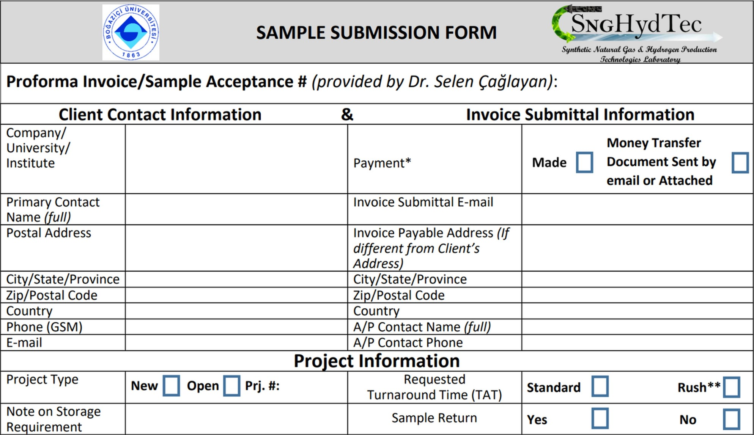
*: PAYMENT MUST BE MADE PRIOR TO SAMPLE SUBMISSION; **: 100% OVERCHARGE FOR RUSH TAT
89

Slide 85

Prof. Dr. Ahmet Erhan Aksoylu
aksoylu@boun.edu.tr
+90 533 399 7954
Dr. Burcu Selen Çaglayan
selenbur@boun.edu.tr
+90 533 581 7376
CONTACT
90

